Slide 1
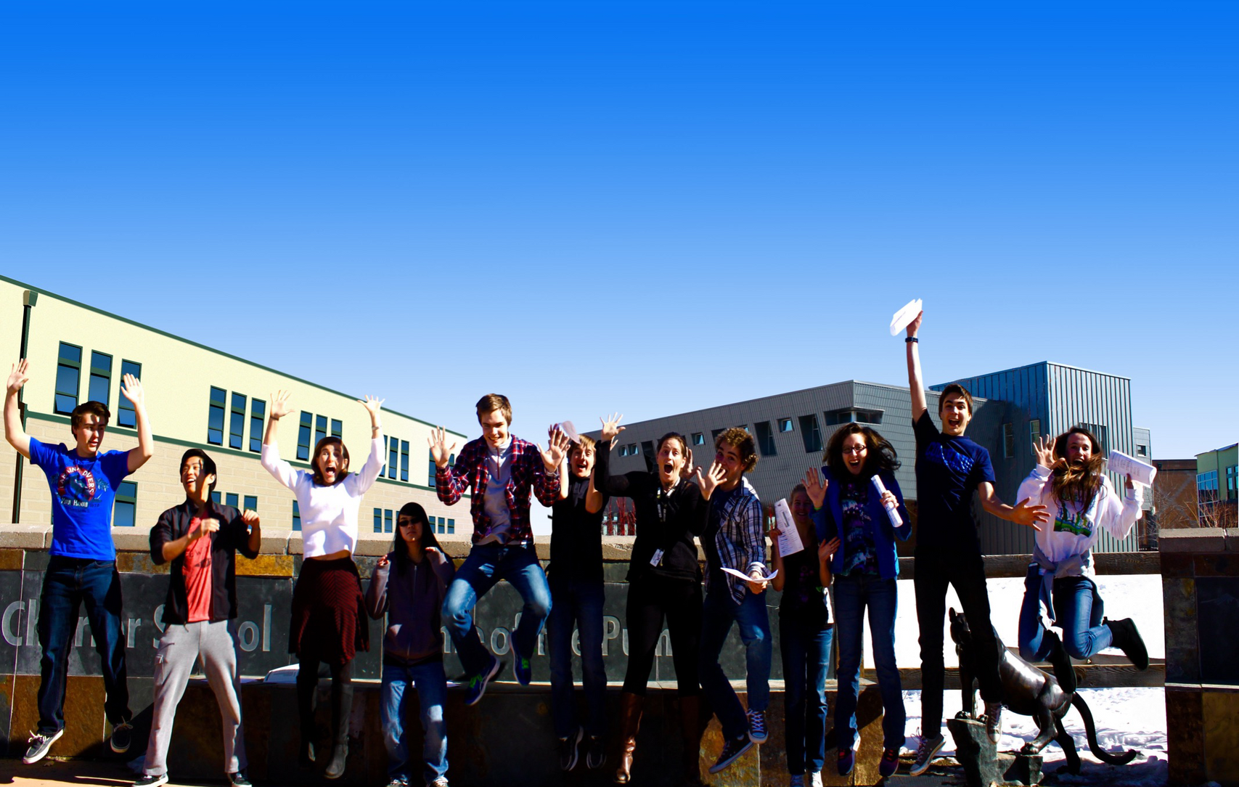
DISC

Slide 2
Behavioral/ Communication Style. What styles do you struggle with?

Slide 3
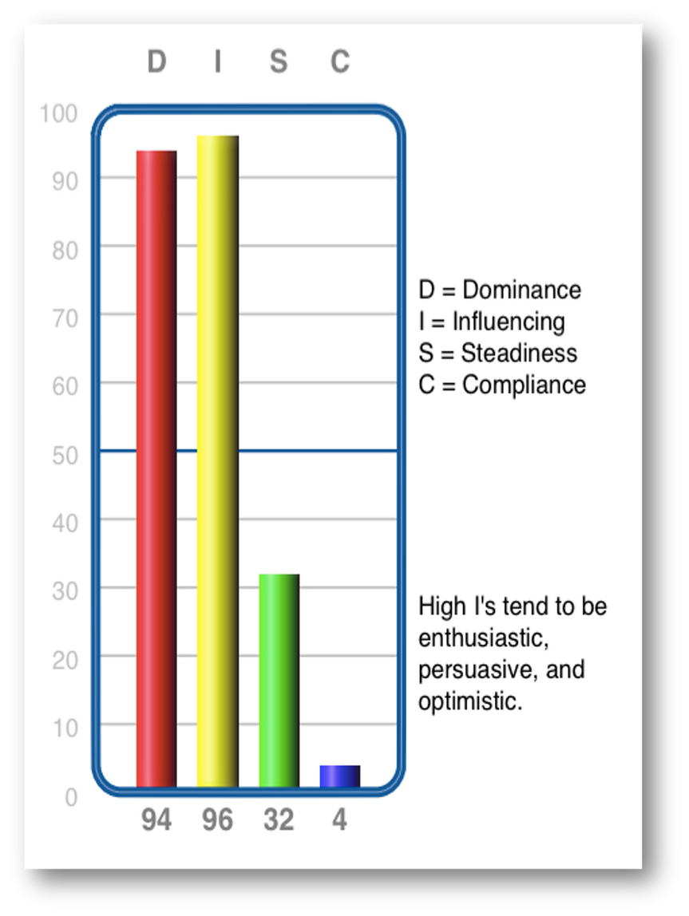
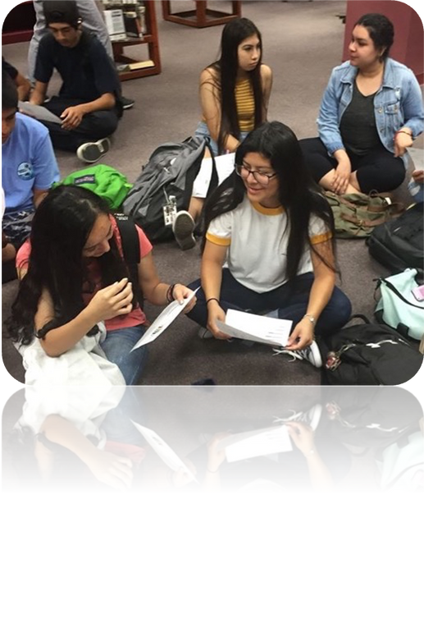
Behaviors (DISC)
Behaviors represent your “personality” and the way you communicate with others.
High
Energy Line
Students in Niagara, NY comparing Indigo Reports
Low

Slide 4
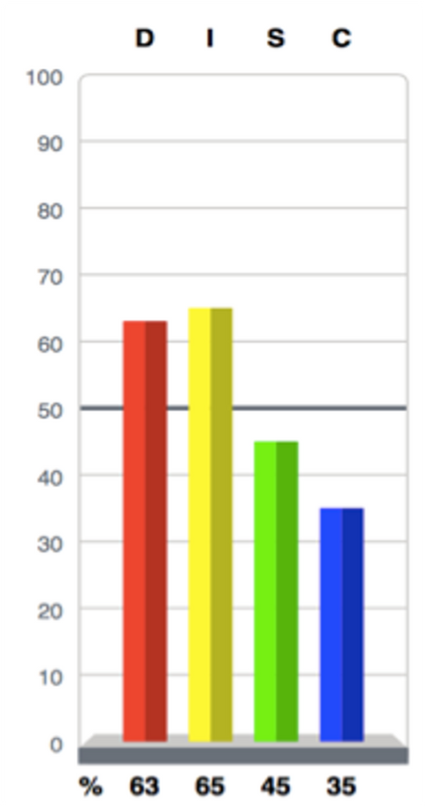
BRIDGE
Evenly spread DISC scores are typically “bridges” on a team.
Evenly Spread Bridge =
All scores are between 30 and 70.
Highly adaptable individuals.

Slide 5
DOMINANCE

Slide 6
HIGH D
LOW D
Share your opinions!
Deals well with Conflict
You get what you want!
Calm and peaceful
Avoid fights
Work well in teams!

Slide 7
INFLUENCING

Slide 8
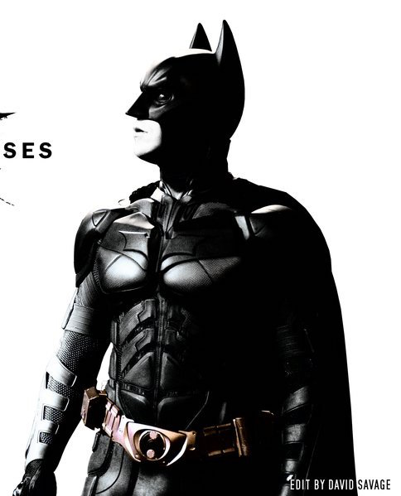
HIGH I
LOW I
Likes to be around people
Really energetic
Loves to talk
Like to think more than talk
Like to work alone
More chill and good listeners

Slide 9
STEADINESS

Slide 10
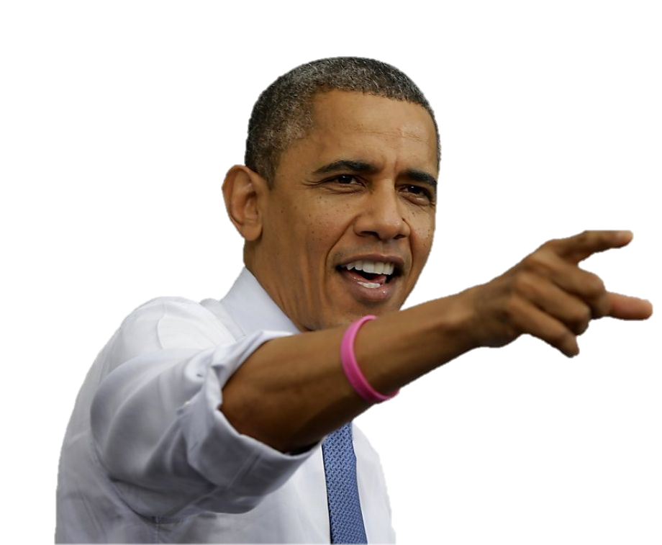
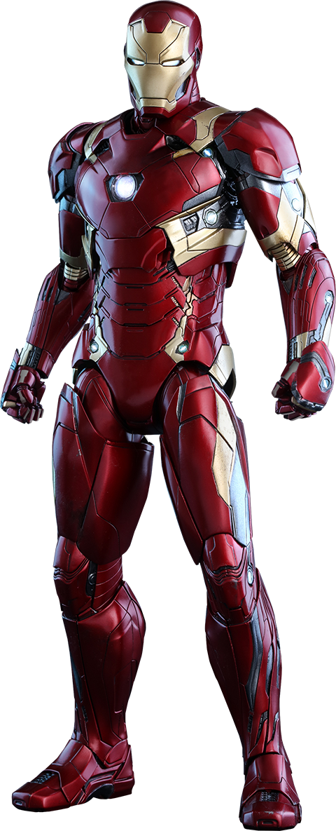
HIGH S
LOW S
Really patient & stay calm
Friends count on you
Like routines
Down to earth
Does a lot of things at once.
Likes to try new things
Can’t sit still.

Slide 11
COMPLIANCE

Slide 12
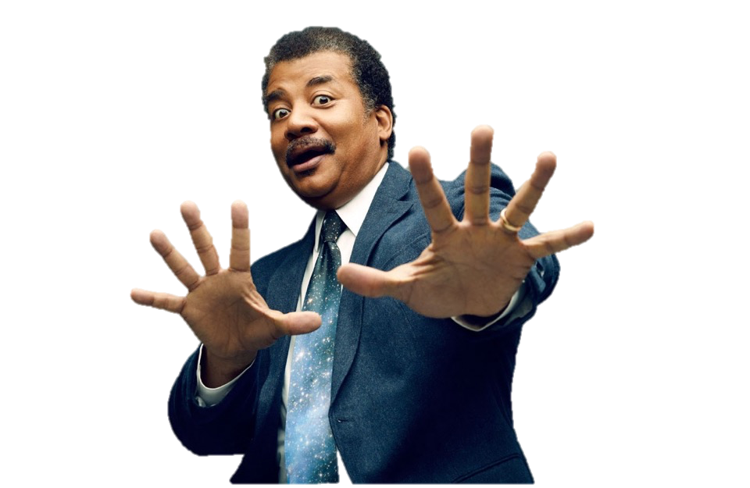
HIGH C
LOW C
Thinking before acting
Great with details
Does things correctly
Good on the fly
Likes to wing it
Results > process

Slide 13
IN BETWEEN ACTIVITY
Here is an opportunity to reflect on the DISC concepts we discussed and apply them for yourself. We will start our next call discussing these two pieces.
1.Your DISC summary - describe yourself in a few words or a short statement using what stands out to you about yourself according to your DISC graph.
2.Differing DISCs - Consider a few people with DISC styles that are different from yours. How does this impact your communication styles and work/personal dynamics? Which styles are most difficult for you and why?

Slide 14
Q&A

Slide 15
Contact Information
www.indigoedco.com
sueann.casey@indigoproject.org
www.linkedin.com/in/sueann-casey-indigo
509-435-5903

